Slide 1

Practical 5

Slide 2
Using SQL Queries to Insert,
Update and Delete Data

Slide 3
Objectives
Learn how to run a script to create database tables automatically
Learn how to insert data into database tables
Learn how to create database transactions and commit data to the database
Create search conditions in SQL queries
Understand how to update and delete database records, and how to truncate tables

Slide 4
Using Scripts to Create Database Tables
One or more SQL commands saved in a text file
Usually have .sql extension
To run from SQL*Plus:
  Start full file path (c:\temp\myfile.sql)
  @full file path (@c:\temp\myfile.sql)
  Extension can be omitted if it is .sql

Slide 5
Inserting Data into Tables
INSERT command adds new records
Field values should match column order, or be specified in command
INSERT INTO faculty (F_ID, F_LAST, F_FIRST, F_MI, LOC_ID) VALUES (1, 'Cox', 'Kim', 'J', 9);
INSERT INTO location VALUES (9, 'BUS', '424', 1);

Slide 6
Format Models
Used to format data retrieved from database
Can be used to format a date to display time or a number to display as a currency

Slide 7
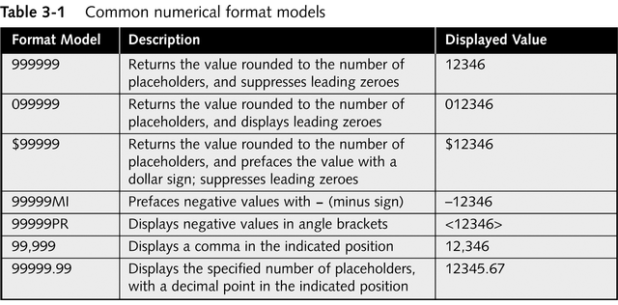
Numerical Format Models

Slide 8
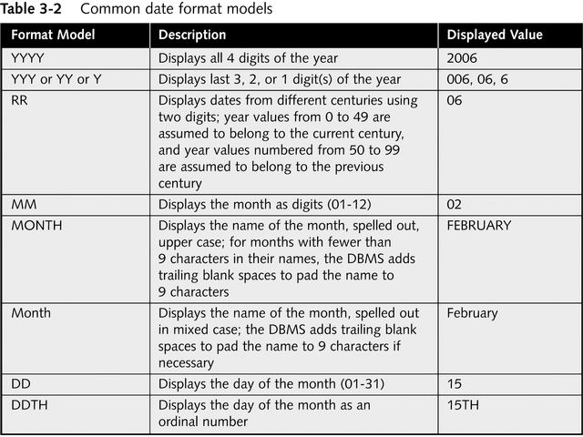
Date Format Models

Slide 9
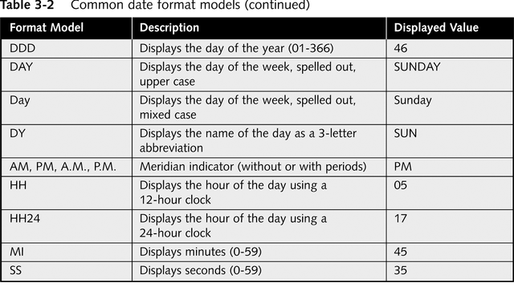
Date Format Models

Slide 10
Inserting Date and Interval Values
Use to_date function to convert a character string to a date
  Specify date string and matching format model
  TO_DATE('08/24/2004', 'MM/DD/YYYY')
  TO_DATE('10:00 AM', 'HH:MI AM')
Use functions to convert character strings to intervals
  TO_YMINTERVAL('4-9') inserts a positive interval of 4 years, 9 months
  TO_DSINTERVAL('0 01:15:00') inserts a positive interval of 4 days, 1 hour, 15 minutes, 0 seconds

Slide 11
Example
INSERT INTO student
VALUES (1, 'Miller', 'Sarah', 'M', '144 Windridge Blvd.', 'Eau Claire', 'WI', '54703', '7155559876', 'SR', TO_DATE('07/14/1985', 'MM/DD/YYYY'), 8891, 1, TO_YMINTERVAL('3-2'));

Slide 12
Inserting LOBs
Before inserting LOB must insert a LOB locator
LOB locator: a structure that contains information that identifies the LOB data type and points to the alternate memory location
Write a program or use a utility to add LOB data to database
Use EMPTY_BLOB() function to insert a LOB locator
INSERT INTO faculty (F_ID, F_LAST, F_FIRST, F_IMAGE)
VALUES (2, 'Blanchard', 'John', EMPTY_BLOB());

Slide 13
Creating Transactions and
Committing New Data
Transaction: series of action queries that represent a logical unit of work
User can commit (save) changes
User can roll back (discard) changes
Pending transaction: a transaction waiting to be committed or rolled back
Oracle DBMS locks records associated with pending transactions
Other users cannot view or modify locked records

Slide 14
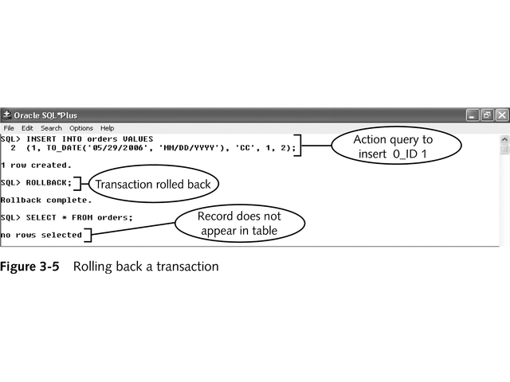
Commit and Roll Back in SQL*Plus
Transactions begin automatically with first command
Type COMMIT to commit changes
Type ROLLBACK to roll back changes

Slide 15
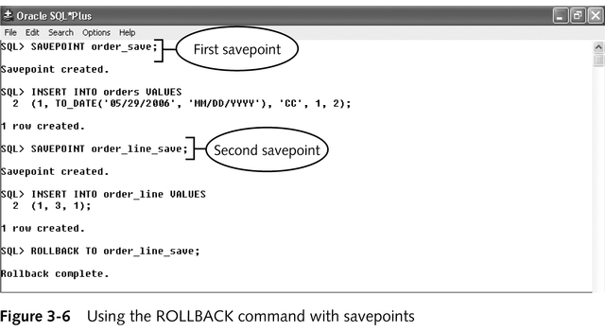
Savepoints
A bookmark that designates the beginning of an individual section of a transaction
Changes are rolled back to savepoint

Slide 16
Creating Search Conditions in SQL Queries
An expression that seeks to match specific table records
Used in SELECT, UPDATE and DELETE statements
WHERE fieldname comparison_operator search_expression
WHERE S_ID = 1

Slide 17
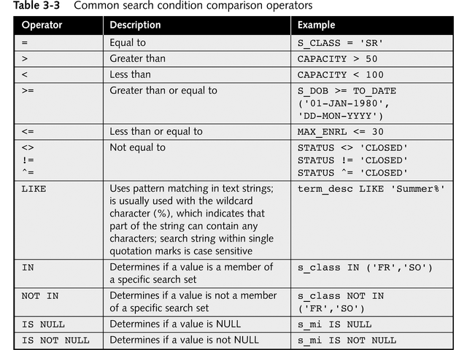
Comparison Operators

Slide 18
Defining Search Expressions
Character strings
  Must be enclosed in single quotes
  Case sensitive
Dates
  Use to_date function with date string and format model
Intervals
  Use to_yminterval and to_dsinterval with interval string format model

Slide 19
Creating Complex Search Conditions
Combines multiple search conditions using the AND,OR, and NOT logical operators.
AND – both conditions must be true
OR – one or both condition must be true
NOT – opposite of actual value
Use () to group logical operators

Slide 20
Updating and Deleting
Existing Table Records
UPDATE:
  Updates field values in one or more records in a table
  Only one table may be updated at a time
  UPDATE tablename SET field1= new_value1, field2 = new_value2, ... WHERE search condition;
  UPDATE faculty
  SET f_rank = 'FULL'
  WHERE f_id = 1;
DELETE:
  Removes specific records from a database table
  If search condition is omitted, entire table data is removed
  DELETE FROM tablename WHERE search condition;
  DELETE FROM student
  WHERE s_first = 'Sarah'
  AND s_last = 'Miller';

Slide 21
Updating and Deleting
Existing Table Records
TRUNCATE
  Removes all of the table data without saving any rollback information
  Must disable foreign key constraints before truncating table
  TRUNCATE TABLE tablename;

Slide 22
Example
INSERT INTO location VALUES
(10, 'CR', '105', 150);
ALTER TABLE faculty
DISABLE CONSTRAINT faculty_loc_id_fk;
ALTER TABLE course_section
DISABLE CONSTRAINT course_section_loc_id_fk;
TRUNCATE TABLE location;
SELECT * FROM location;

